Slide 1

TKR COLLEGE OF ENGINEERING AND TECHNOLOGY
(Autonomous, Accredited by NAAC with ‘A’ Grade)
Department of Computer Science & Engineering
B. Tech IV Year II Semester
PROJECT PART - B

Slide 2
REVIEW-2

Slide 3
PROJECT GUIDE:
Dr. Ch. B N Lakshmi
TEAM DETAILS:
19K91A0505 Afsha
19K91A0506 A Vignesh
19K91A0549 Ch Srijan
19K91A0555 D Raju

Slide 4
PROJECT TITLE
A MODEL TO PREDICT HEART DISEASE USING MACHINE LEARNING
TEAM NO : A9
BRANCH/SEC : CSE-A

Slide 5
DESIGN

Slide 6
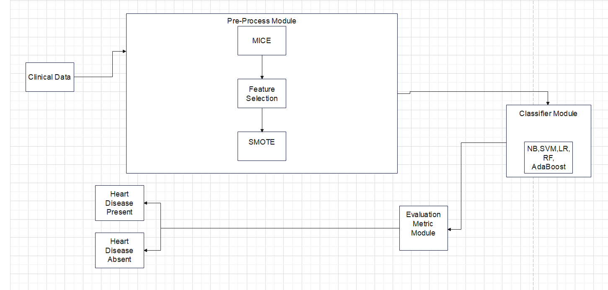
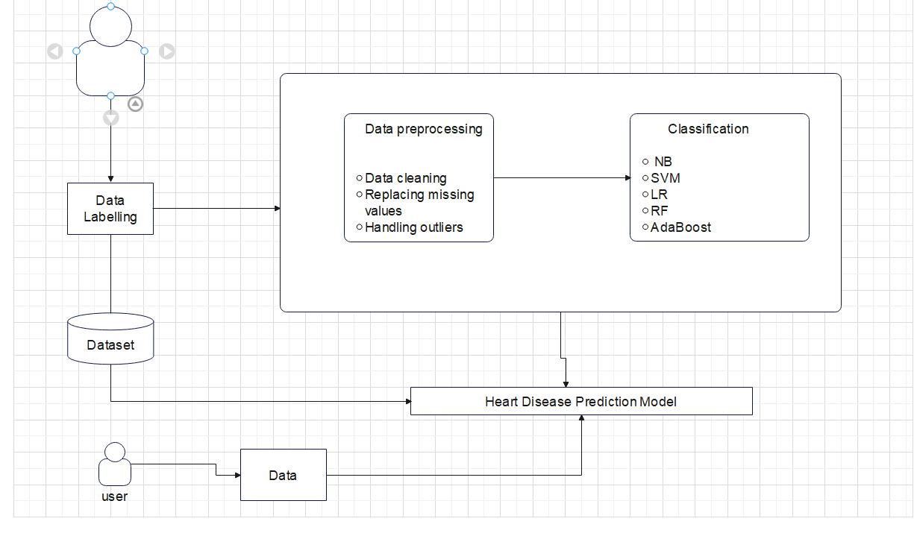
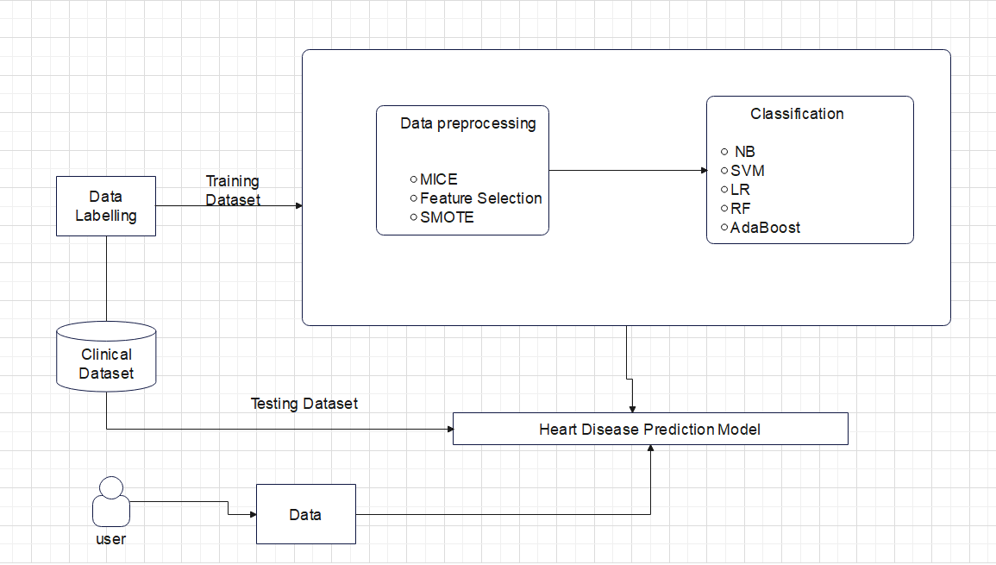
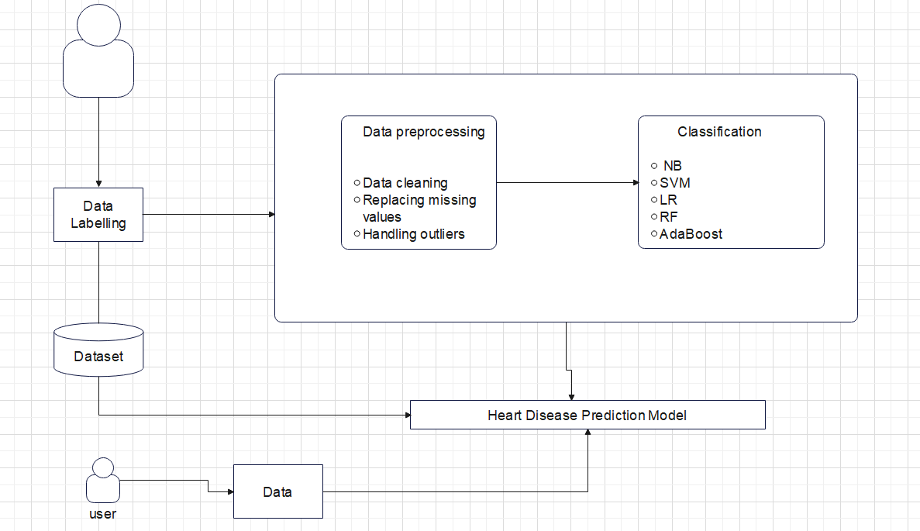
1. SYSTEM ARCHITECTURE

Slide 7
2. PROJECT MODULES
There are 3 modules in our project. They are
Pre-process module
Classifier module
Evaluation Metric module

Slide 8
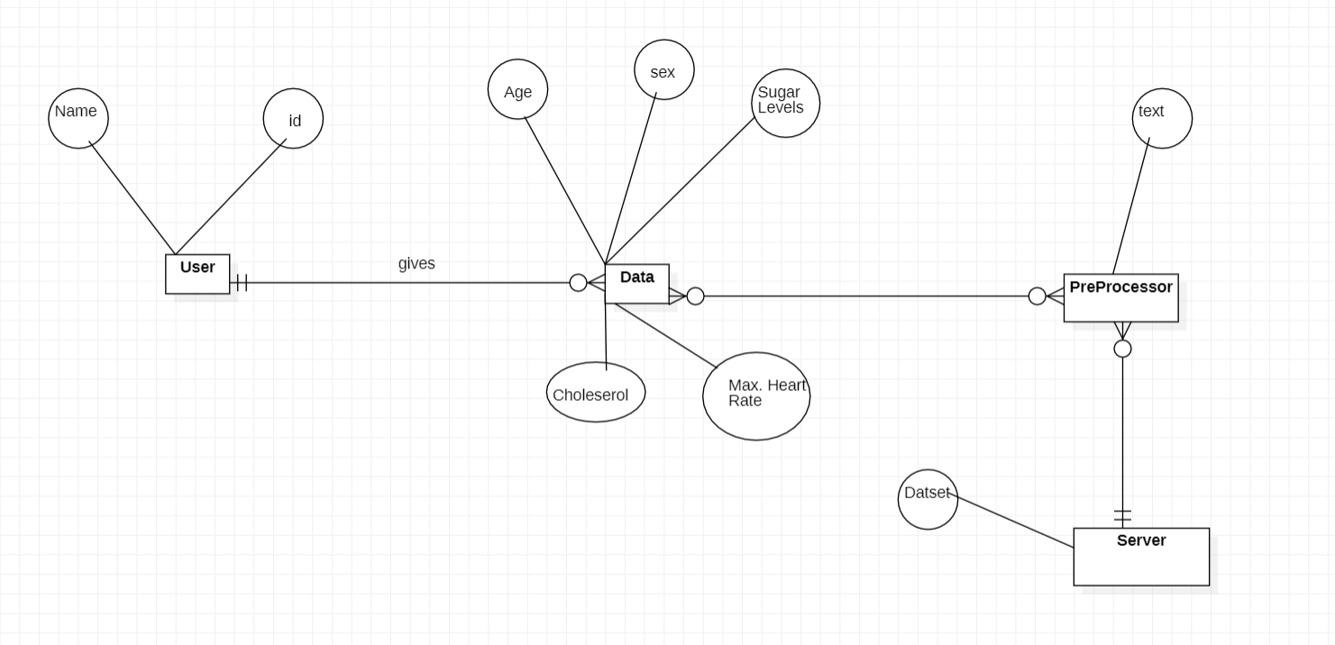
3. ER DIAGRAM

Slide 9
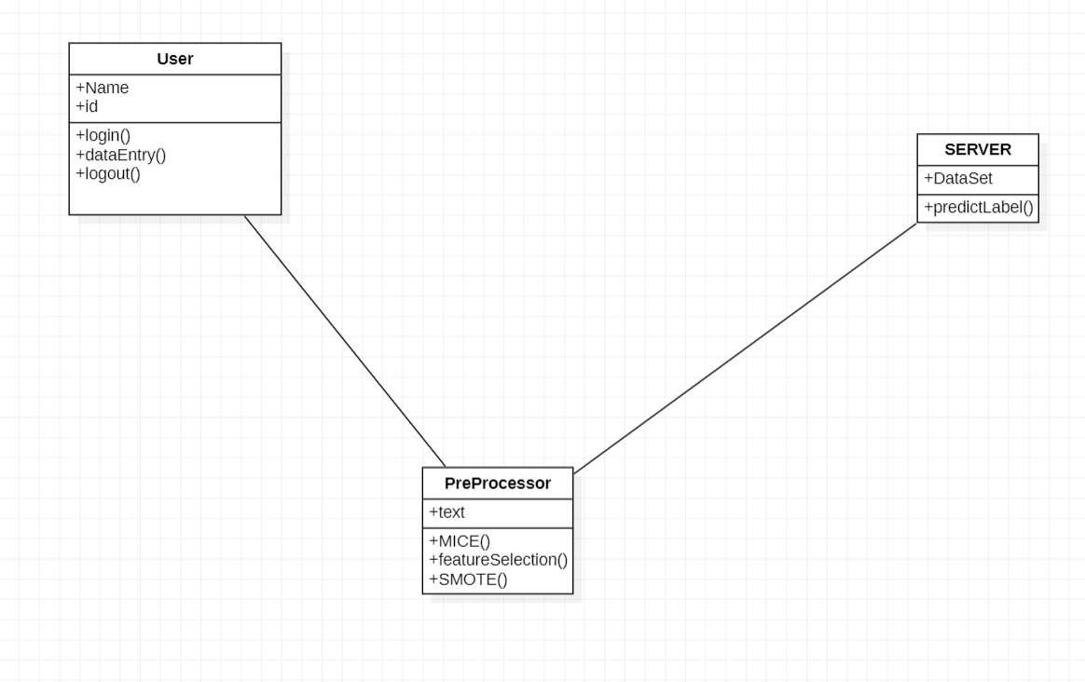
UML DIAGRAMS
Class Diagram

Slide 10
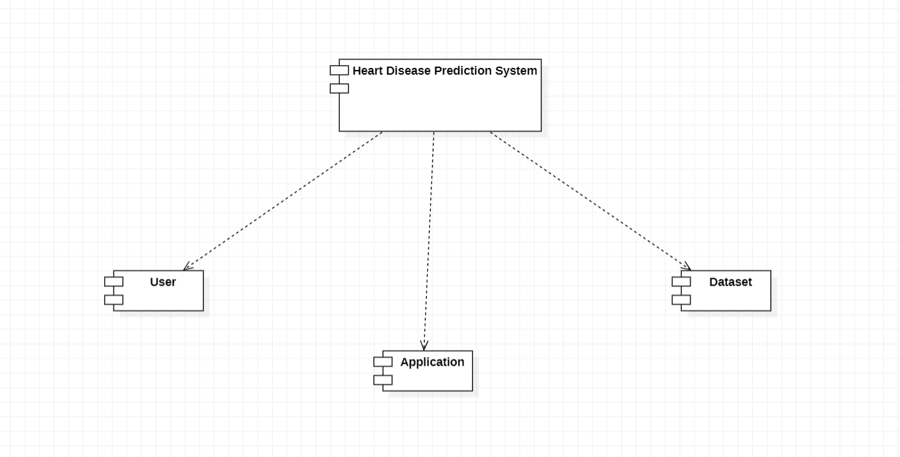
The purpose of a component diagram is to show the relationship between different components in a system
UML DIAGRAMS
2. COMPONENT DIAGRAM

Slide 11
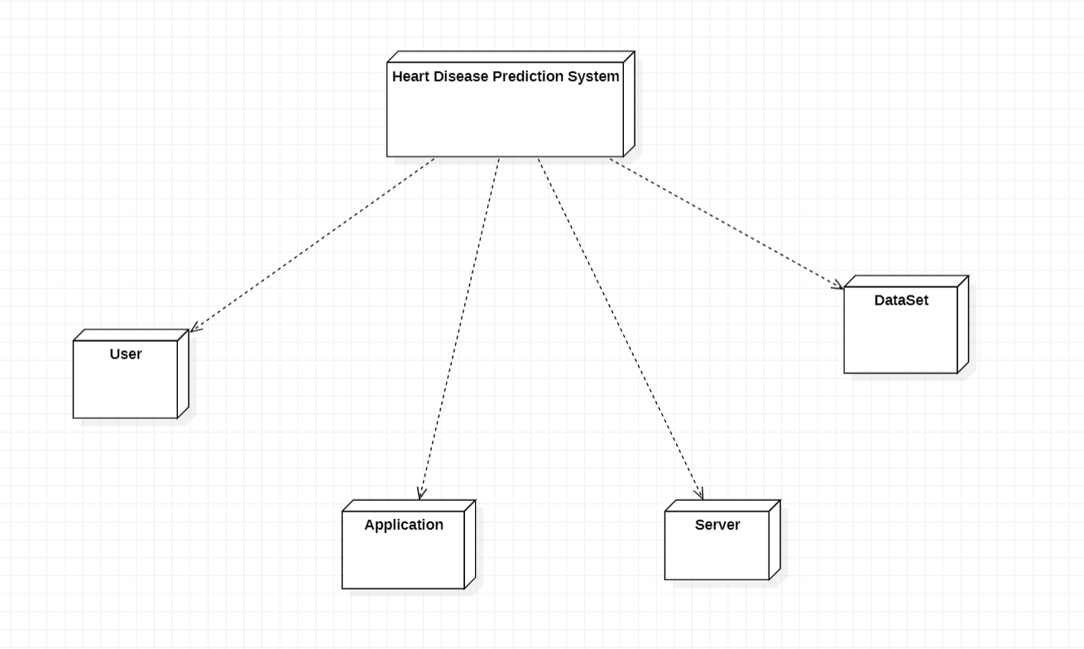
A deployment diagram is a UML diagram type that shows the execution architecture of a system
UML DIAGRAMS
3. DEPLOYMENT DIAGRAM

Slide 12
Thank You

